Slide 1

IT Architecture for NLS / Nordic Learning Solutions
Focus: Strategy, Stakeholders & Processes
Methods: Balanced Scorecard, BMC, BPMN
Diana, Tesnim, Ibrahim & Adrian / Group 4

Slide 2
Our business and main objectives
NLS provides an AI supported learning platform
For school, universities and corporate training
Main objectives
Improve learning outcomes for students
Increase revenue by expending into corporate customers
Strategic focus
Personalised learning, scalable cloud platform, data driven decisions

Slide 3
Stakeholders and Internal drivers
Key stakeholders
Students, teachers, administrators
Management, developers, IT architects
Data & Analytics team, Customer support, DPO

Slide 4
External Drivers
Market Forces & External Drivers
Digitalisation: Expectation of modern e-learning.
Competition: Global EdTech giants pushing UX standards.
️ Regulation: GDPR & National Education Acts.
Integration Needs: Seamless SSO & LMS connections.

Slide 5
Balanced Scorecard for NLS
Financial Perspective Objective: Increase revenue & profitability Strategy: • Tiered subscription models • Corporate training offers | Customer Perspective Objective: Higher satisfaction & retention Strategy: • Improve AI recommendations • Enhance User Experience (UX)
Internal Process Perspective Objective: Efficient onboarding & reporting Strategy: Standardise workflows Automate with AI support | Learning & Growth Perspective Objective: Competence in AI, Analytics & Cloud Strategy: Continuous staff training Knowledge sharing

Slide 6
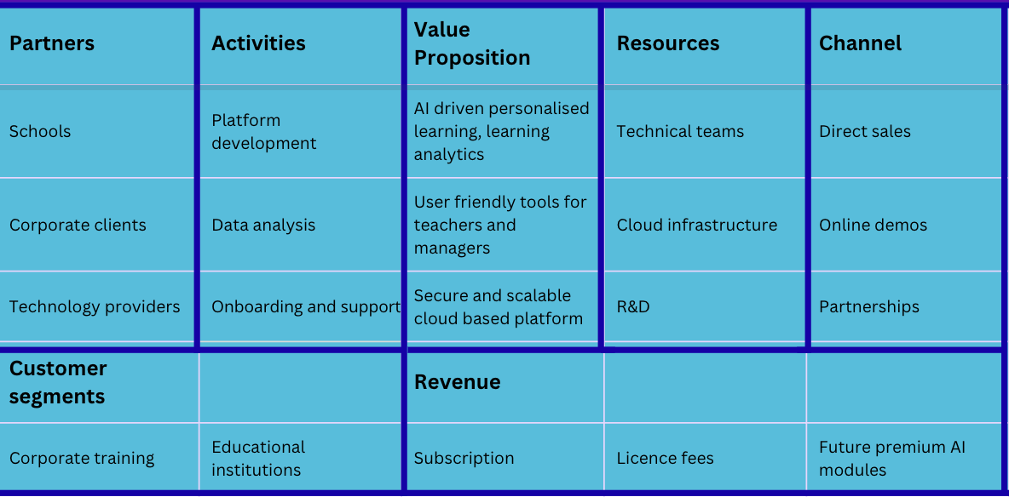
Business Model Canvas (BMC)

Slide 7
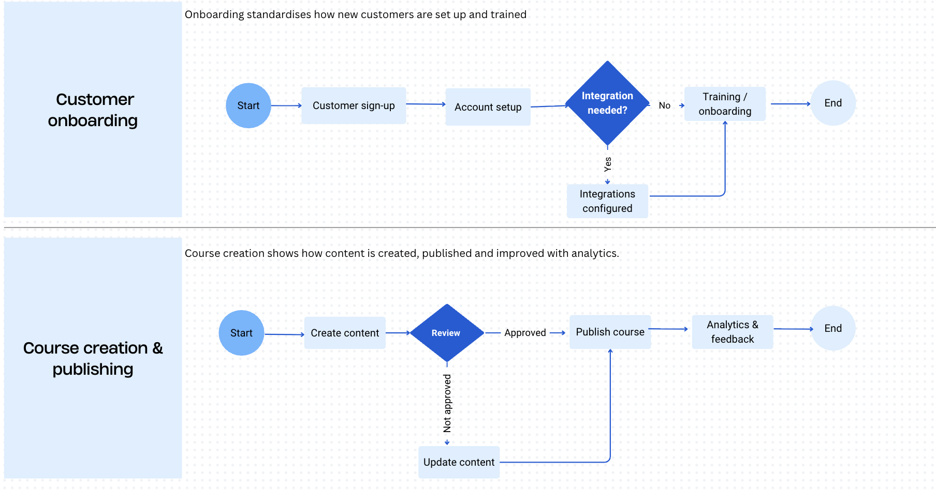
BPMN: Core business processes

Slide 8
Views, viewpoints and conclusion
Stakeholder viewpoints
Management: growth, revenue, risk, long term scalability
Teachers: usability, reliability, pedagogical value, clear AI feedback
DPO and regulators: GDPR, data flows, access control, explainable AI
Conclusion
Balanced Scorecard links strategy to concrete goals
Business Model Canvas shows how NLS creates and captures value
BPMN clarifies key processes like onboarding and course creation
Together they align business strategy, IT architecture and stakeholder needs

Slide 9

Thank you, Questions?

